Slide 1





La peer-review
Isabelle Boutron
METHODS team
Research Centre and Epidemiology an Statistics (CRESS)
Université Paris Cité
1

Slide 2
Besoin de données factuelles fiables
L'écosystème scientifique s'appuie principalement sur le processus d'évaluation par les pairs pour déterminer quels résultats d'études sont dignes de confiance et peuvent être publiés.
« Peer review is at the heart of the processes of not just medical journals but of all of science »
Richard Smith J R Soc Med 2006

Slide 3
The role of the peer-review process is questioned
Costly and not sustainable
  Estimation that 63,4 million hours devoted to peer-review in 2015¹
  US$ 6 billion in 2020³
Delay access to results
  COVID-19 pandemic: a 1-month delay in the results on the effect of steroids (RECOVERY trial) could cost about 200 lives
¹ Kovanis et al. Plos One 2016
² Knowlson, Torgerson F1000 2020
³ LeBlanc et al. Res Integr Peer Rev 2023

Slide 4
Le processus de peer-review
Pierre angulaire de la diffusion de résultats scientifiques fiables
2 objectifs majeurs
  ‘Gatekeeper’
  Amélioration de la qualité des manuscrits
Un système qui s’appuie sur du volontariat
Retard accès aux résultats
  COVID-19 pandemic: a 1-month delay in the results on the effect of steroids (RECOVERY trial) could cost about 200 lives

Slide 5
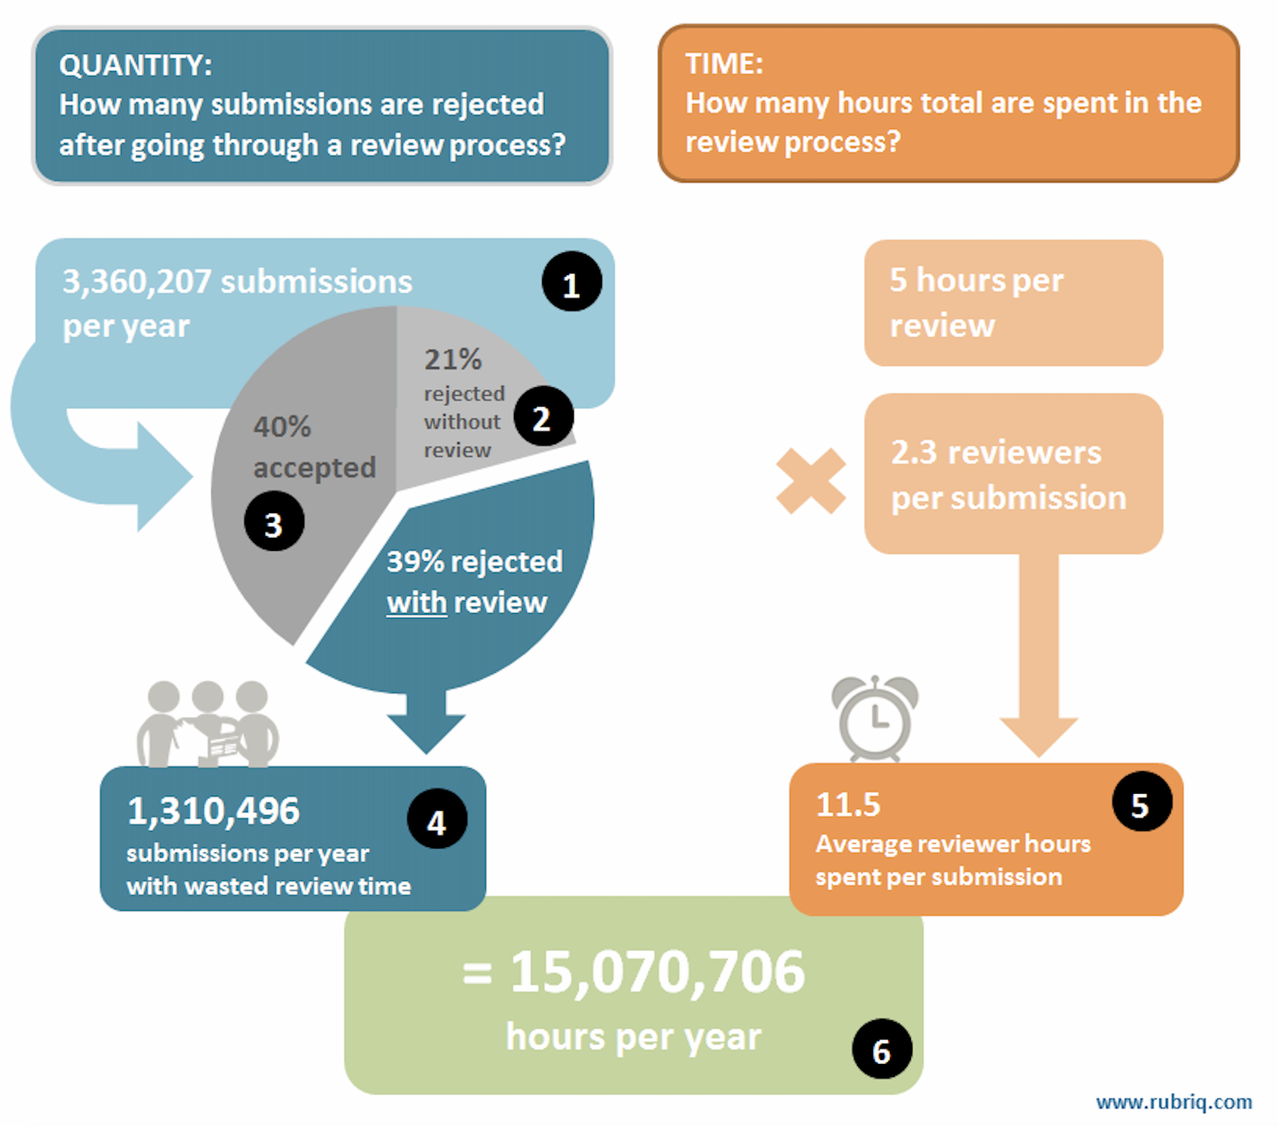
The peer review system
Costly and not sustainable
  Estimation that 63,4 million hours devoted to peer-review in 2015¹
  US$ 6 billion in 2020³
*Look H, Summary report: Rightscom Ltd for JISC Collections; 2010

Slide 6
Les objetifs sont-il atteints

Slide 7
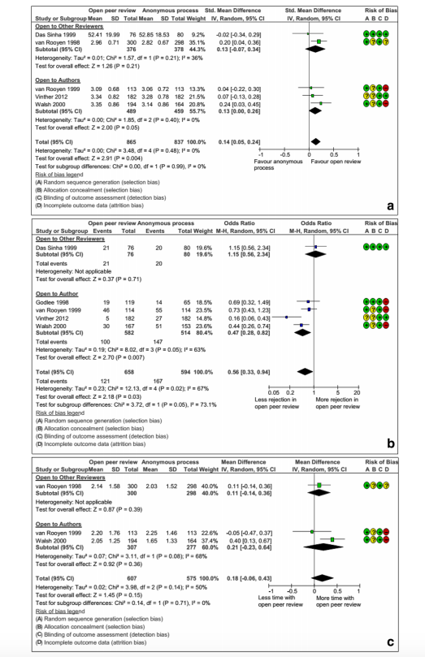
Quel niveau de preuve
A Systematic Review and Meta-analysis of Interventions to Improve the Quality of Peer Review
Only 22 reports of RCTs
Interventions assessed
  Blinding
  Open peer review
  Training
  Use of checklist
  Adding experts (statistical reviewer)
Most are performed in one single journal
Low methodologic quality
Bruce, Chauvin, Trinquart, Ravaud, Boutron. BMC Med, 2016

Slide 8

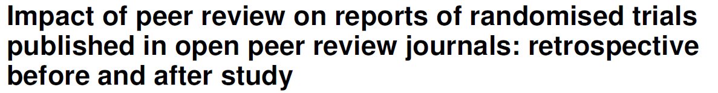
Transparence– Impact du processus de peer review
Comparison of the submitted and accepted versions of manuscripts of RCTs published in open access journals (n=93)
Changes were limited
  A median of 11% (range 1-60%) words deleted and 20% added (range 2-88%).
Hopewell S, BMJ, 2014

Slide 9
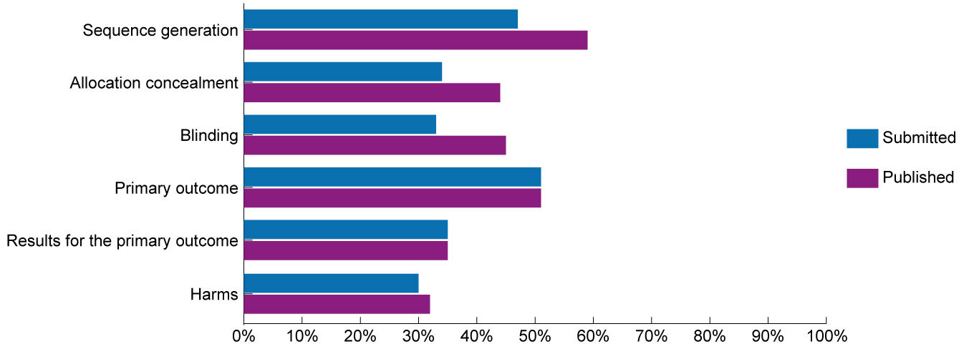
Transparence– Impact du processus de peer review
93 RCTs published
First submission / Peer-reviewers’ comments/ Published article
Hopewell, Collins, Boutron, Yu , Cook, Shanyinde, Wharton, Shamseer, Altman. BMJ, 2014

Slide 10
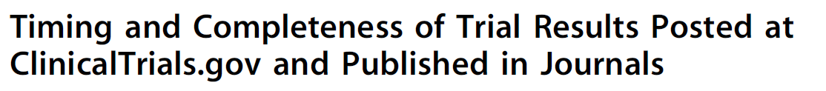

Transparence des résultats publiés (peer-reviewed) vs postés dans les registres d’essais (pas de peer-review)
Sample of randomized controlled trials of drugs with results both posted and published
Completeness of reporting | ClinicalTrials.gov N=202 | Published article N=202 | P-value
Flow of participants | 64% | 48% | <0.001
Efficacy results | 79% | 69% | 0.02
Adverse events | 73% | 45% | <0.001
Serious adverse events | 99% | 63% | <0.001
Riveros Plos Med, 2013

Slide 11
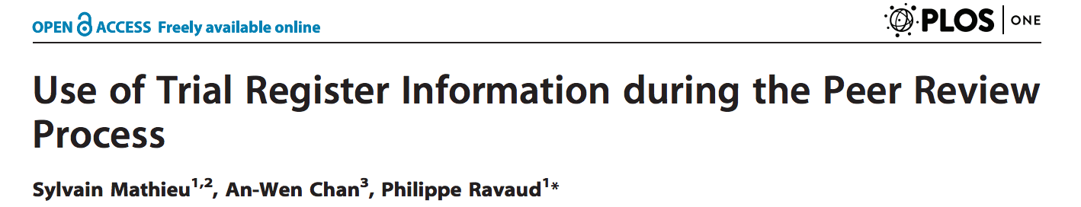
Detection du ‘selective reporting of outcomes’
Survey of 676 authors and reviewers who had reviewed at least 1 article reporting a clinical trial in the past 2 years
34% examined information registered on a trial registry.

Slide 12
Réduction des ‘spin’?
Spin: A way of reporting to convince the reader that the beneficial effect of the experimental treatment (efficacy, safety) is higher than shown by the results
Spin is frequent in published reports
  50% of abstract conclusions of RCTs have spin
Boutron JAMA 2009

Slide 13
Réduction des ‘spin’?
Assessment of the manuscript submitted, peer reviewers comments, and final manuscript of non-randomized studies assessing a therapeutic intervention published in open access journals (n=128).
55% of submitted manuscripts, peer reviewers identified at least one example of spin
Of the spin identified by peer reviewers
  67% were completely deleted,
  16% partially deleted
  17% not removed in the final published article.
For 15%, peer reviewers requested adding some spin
Lazarus, J Clin Epidemiol. 2016

Slide 14
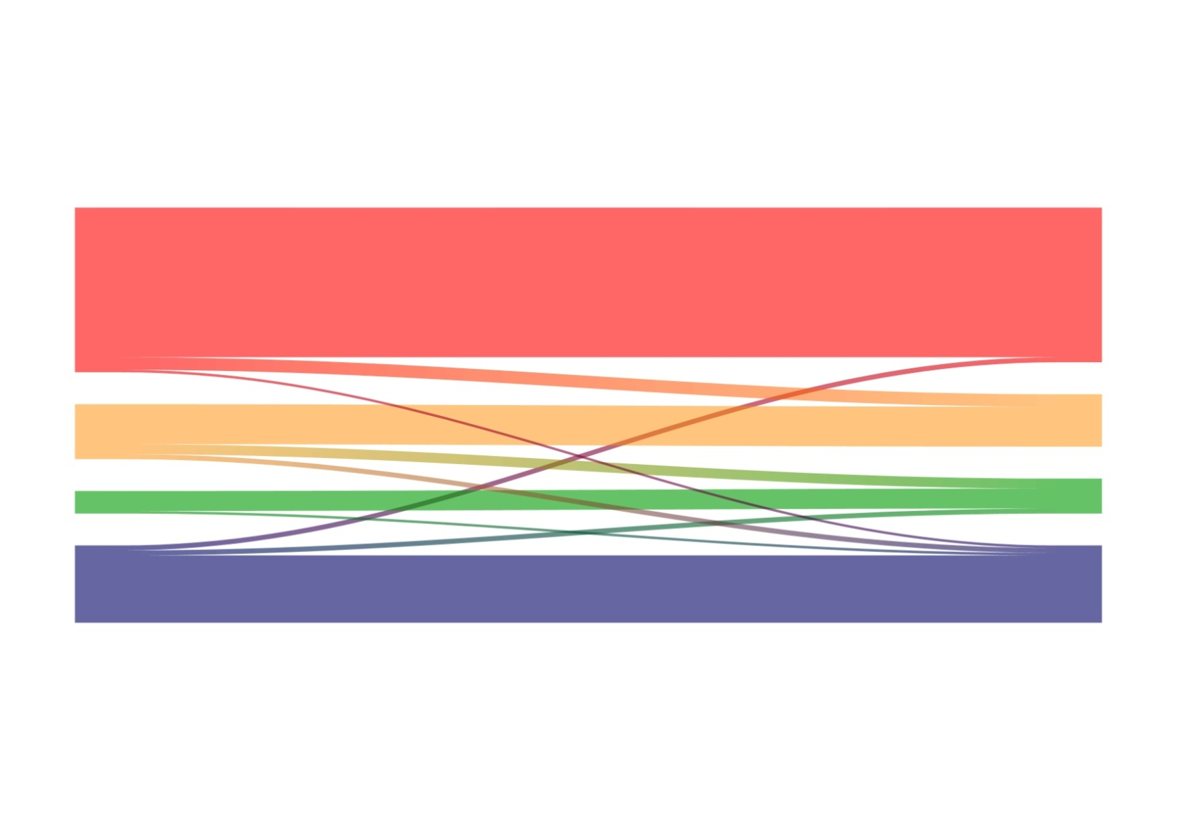
Réduction des ‘spin’?
Before peer-review
After peer-review
High
N=66
N=61
Moderate
N=24
N=24
Low
N=10
N=17
No
N=28
N=26
76% Peer reviewers failed to identify spin in abstract conclusions
Lazarus, J Clin Epidemiol. 2016

Slide 15
Le processus d'évaluation par les pairs est-il exact ?

Slide 16
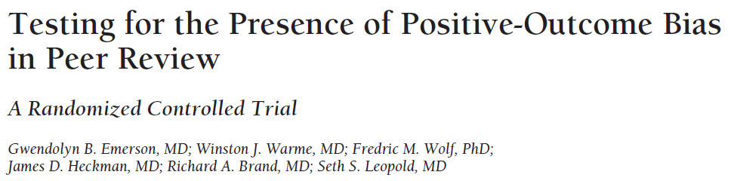
Two versions of a well-designed randomized controlled trial that differed only in the direction of the finding of the principal study end point
238 reviewers at 2 journals (assigned at random)
were more likely to recommend the positive version of the test manuscript for publication than the no-difference version
(97% vs 80%, P<0.001)
detected more errors in the no-difference version than in the positive version (mean 0.85 vs 0.41, P<0.001)
awarded higher methods scores to the positive manuscript than to the (identical) no-difference manuscript (8.24 vs 7.53, P=0.005)

Slide 17
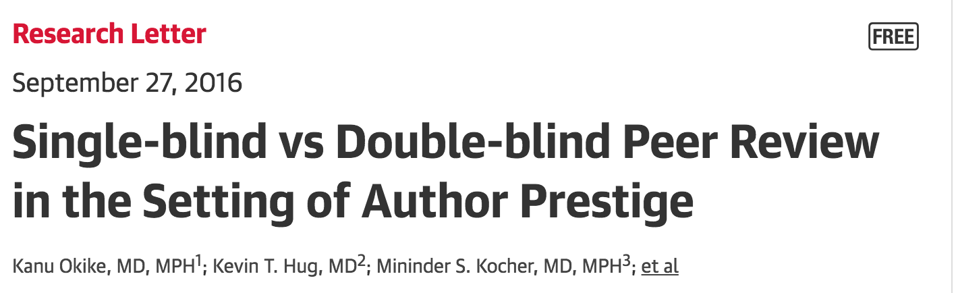
Influence of authors’ prestige
  119 reviewers were randomized to assess a fabricated manuscript with the prestigious authors’ names and institutions masked or visible
  Reviewers were more likely to recommend acceptance when the prestigious authors’ names and institutions were visible than when they were redacted
    87% vs 68%;
    RR, 1.28 [95% CI, 1.06-1.39], P = .02
  They gave higher ratings for the methods.

Slide 18
Quel est le problème?

Slide 19
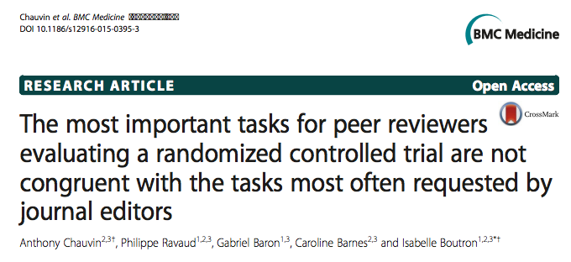
The tasks expected from a peer-reviewer are not realistic
  More than 200 different tasks identified
  The tasks involved different level of expertise and different backgrounds
    Statistical and methodologic expertise
    Content expertise (novelty, relevance, external validity etc)
    None
      Verification (adherence to guidelines, consistency with registries)
      Formatting

Slide 20
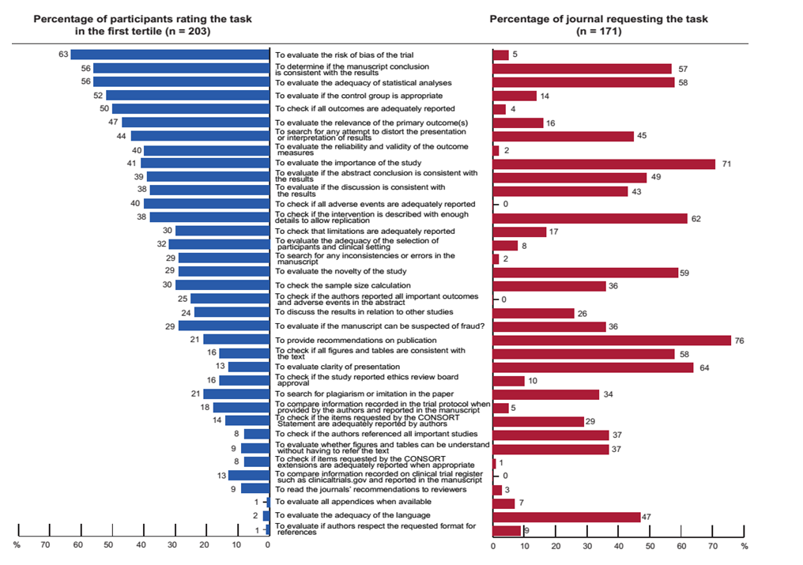
Importance des tâches
Chauvin, BMC Medicine, 2016
The most important task for peer reviewers (evaluating the risk of bias) was clearly requested by 5 % of editors.
The task most frequently requested by editors (provide recommendations for publication), was rated in the first tertile only by 21 % of all participants.

Slide 21
A 2-step peer-review system to improve completeness of reporting. Theoretical background of the intervention
Peer-reviewers consider that assessing adherence to reporting guidelines and switch in outcomes is not their remit.
Detection of inadequate reporting does not involve high level of expertise and could be performed by early career researchers who would gain expertise in peer-review.
Online tool and a training module could early career researchers detected misreported items and switched outcomes when evaluating a report of a RCT.

Slide 22
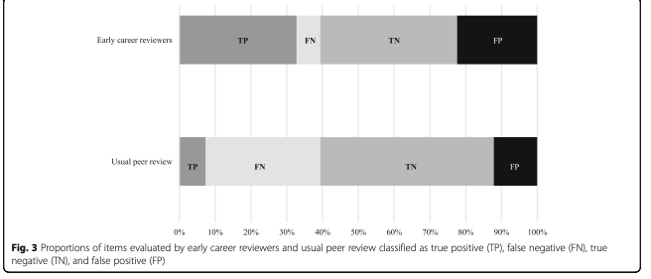
Results
The mean (SD) number of domains (0 to 9) accurately classified per manuscript
  6.39 (1.49) COBPeer versus 5.03 (1.84) usual peer-review process
  mean difference = 1.36 [0.88-1.84] (p < 0.001)
Sensitivity of ECRs using COBPeer versus the usual peer-review process
  Incomplete reporting 86% [95% CI 82-89] versus 20% [16-24]
  switch in primary outcome 61% [44-77] versus 11% [3-26].
Specificity of ECRs using COBPeer versus the usual process
  Incomplete reporting 61% [57-65] versus 77% [74-81]
  switch in primary outcome 77% [67-86] versus 98% [92-100 ]

Slide 23

Que faire?

Slide 24

What could be done?

Slide 25


Confiance dans les preprints?
RECOVERY
dexamethasone¹
Are preprints reliable?²
bioRxiv preprint suggests that SARS-CoV-2 has similarities to HIV
SSRN preprint suggests that ivermectin improves survival from COVID-19
Research Square preprint on ivermectin
preprint
1 month
peer-reviewed journal
700,000
new COVID-19 cases
RETRACTED
1. Horby P, Nat Med, 2022
2. Watson C, Nat Med, 2022
3. Boutron I et al., Ann Intern Med, 2020

Slide 26
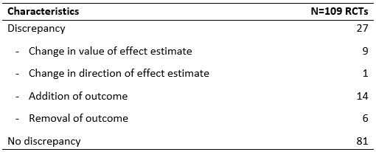
Confiance dans les preprints?

Slide 27
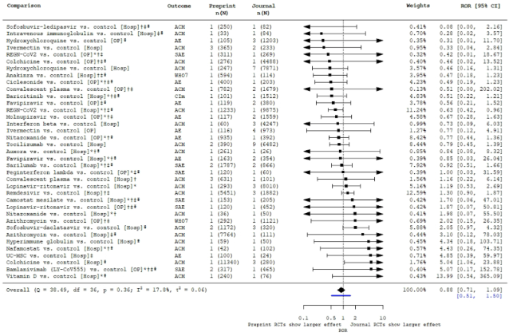
Confiance dans les preprints?

Slide 28
Evaluation

Slide 29
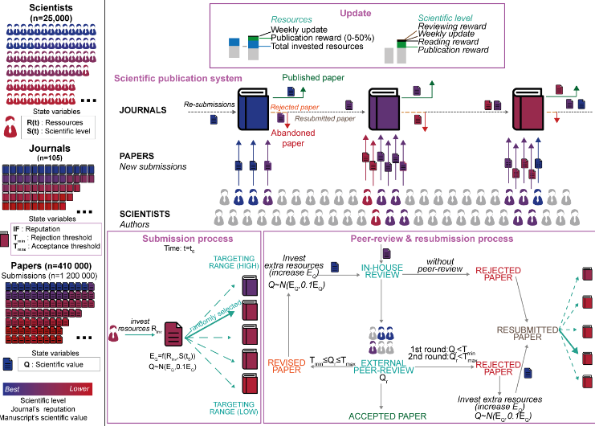
Modeling (Agent-based model)
Kovanis Plos One 2016
Kovanis Scientometrics. 2016
To approach the complexity of the scientific publication system and compare different systems
Explore sustainability of the system
Compare different systems (cascade etc)

Slide 30
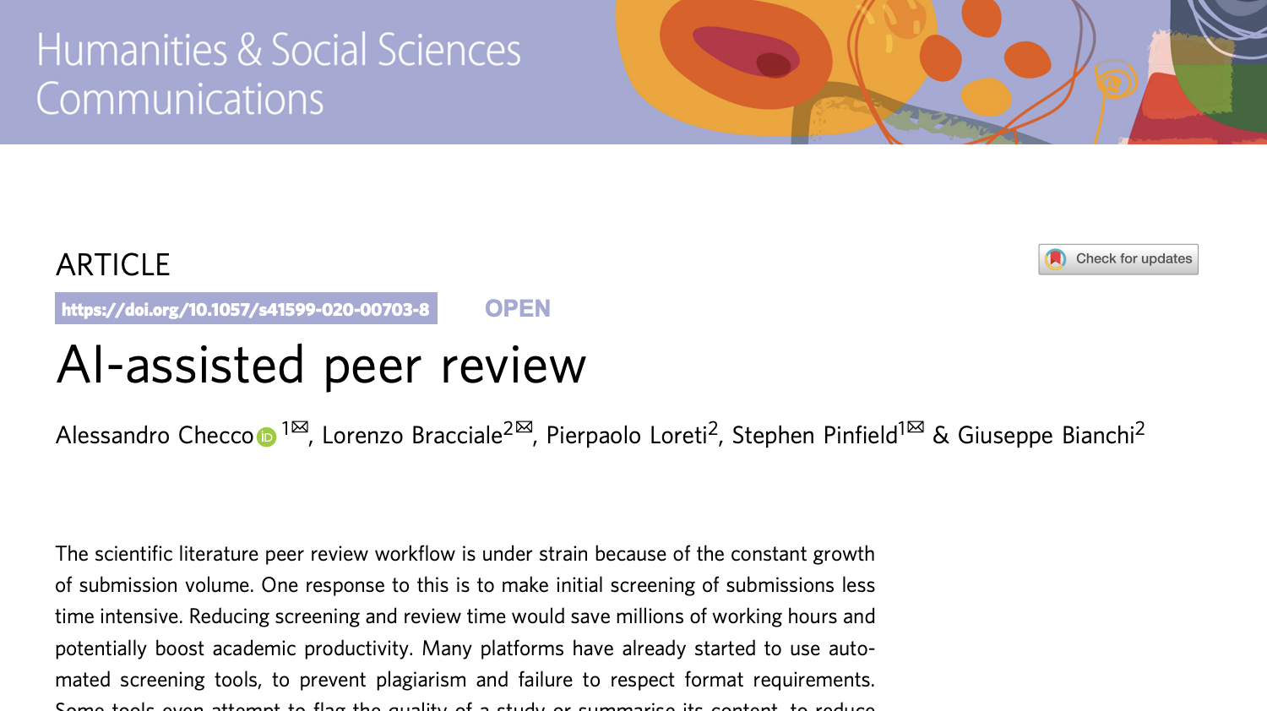
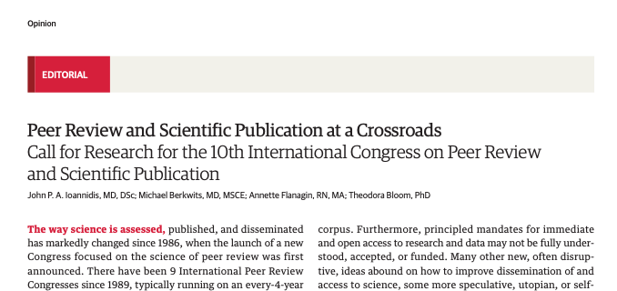

Slide 31
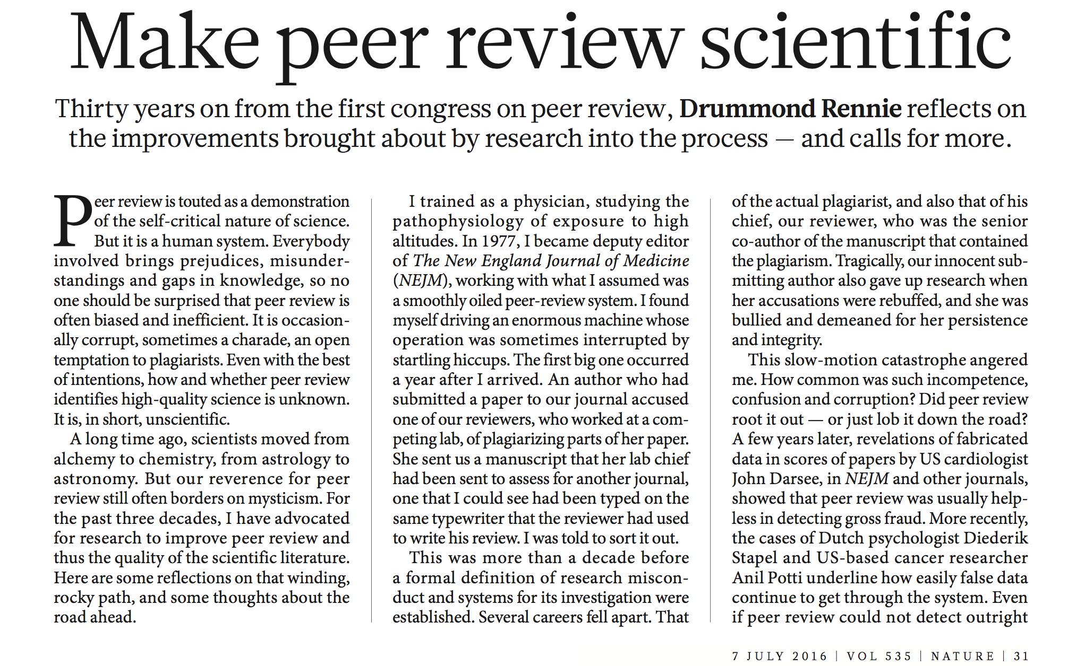
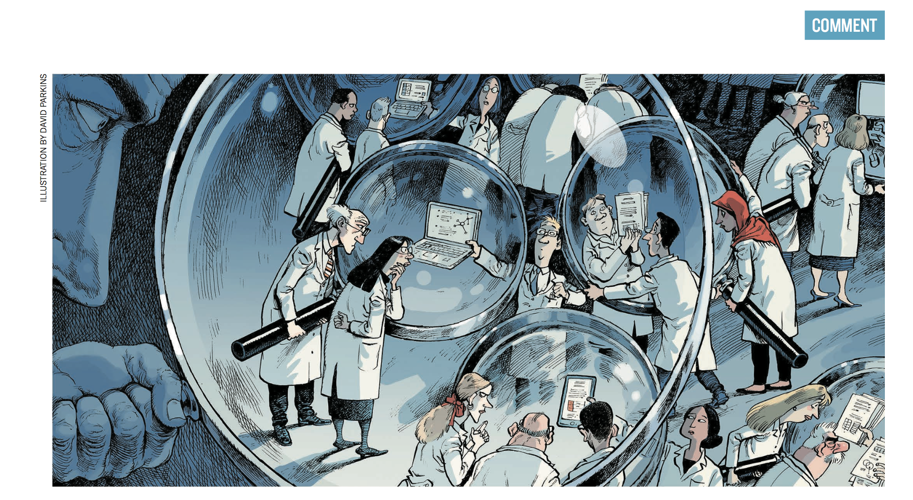

Slide 32
Conclusions
“So peer review is a flawed process, full of easily identified defects with little evidence that it works. Nevertheless, it is likely to remain central to science and journals because there is no obvious alternative.”
“The most important question with peer review is not whether to abandon it, but how to improve it.”
(R. Smith)
“We need rigorous studies to tell us the pros and cons of these approaches.” (D Rennie)

Slide 34
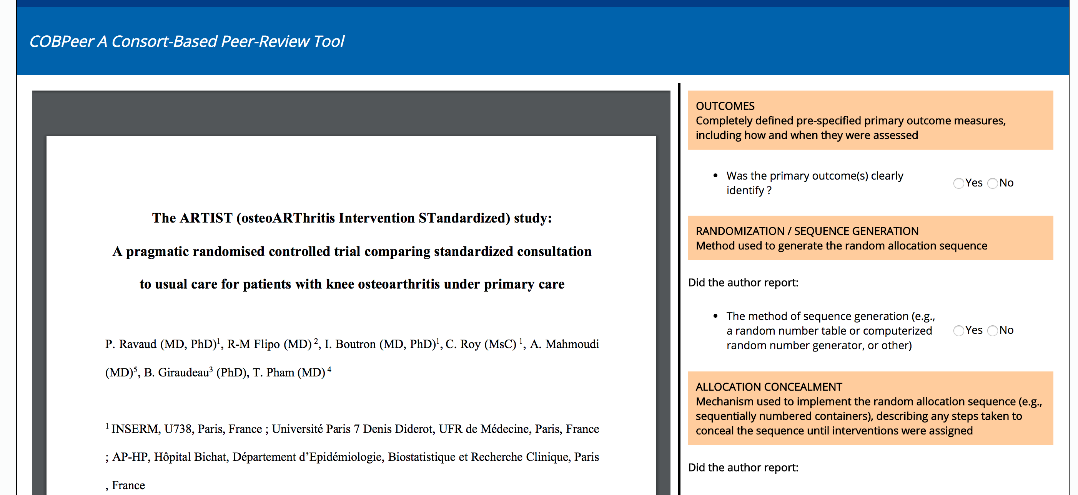
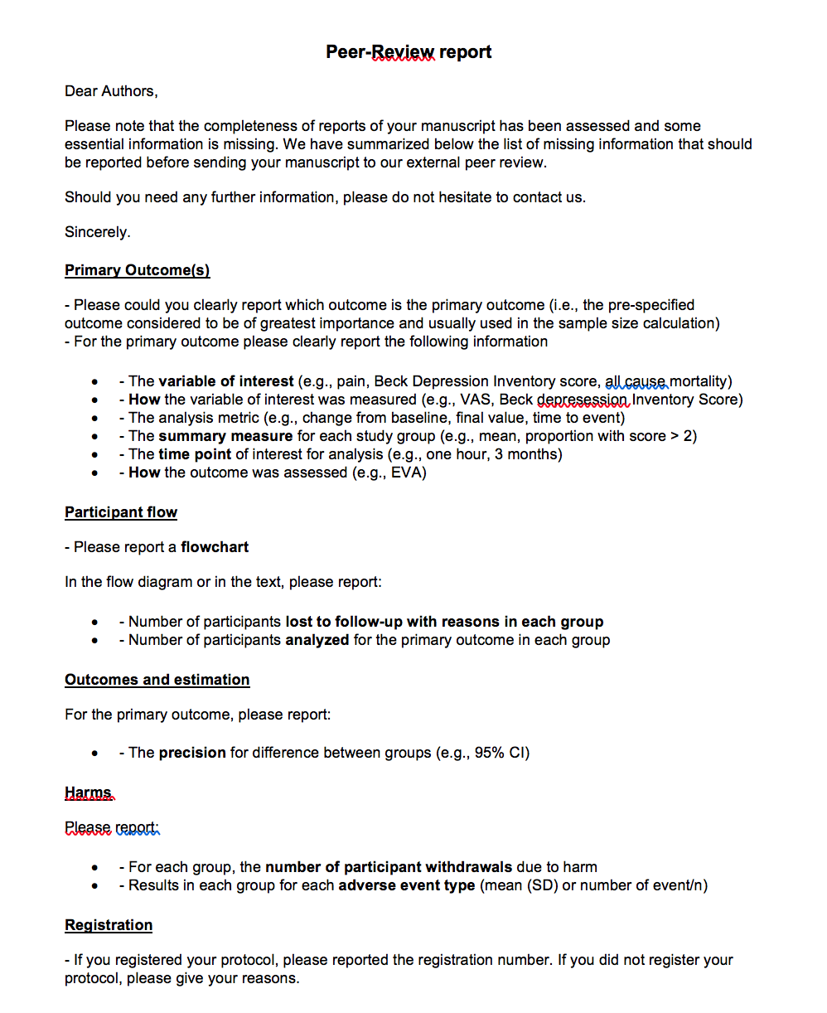
Development of the intervention - COBPeer
Automatically generated peer-review report

Slide 35
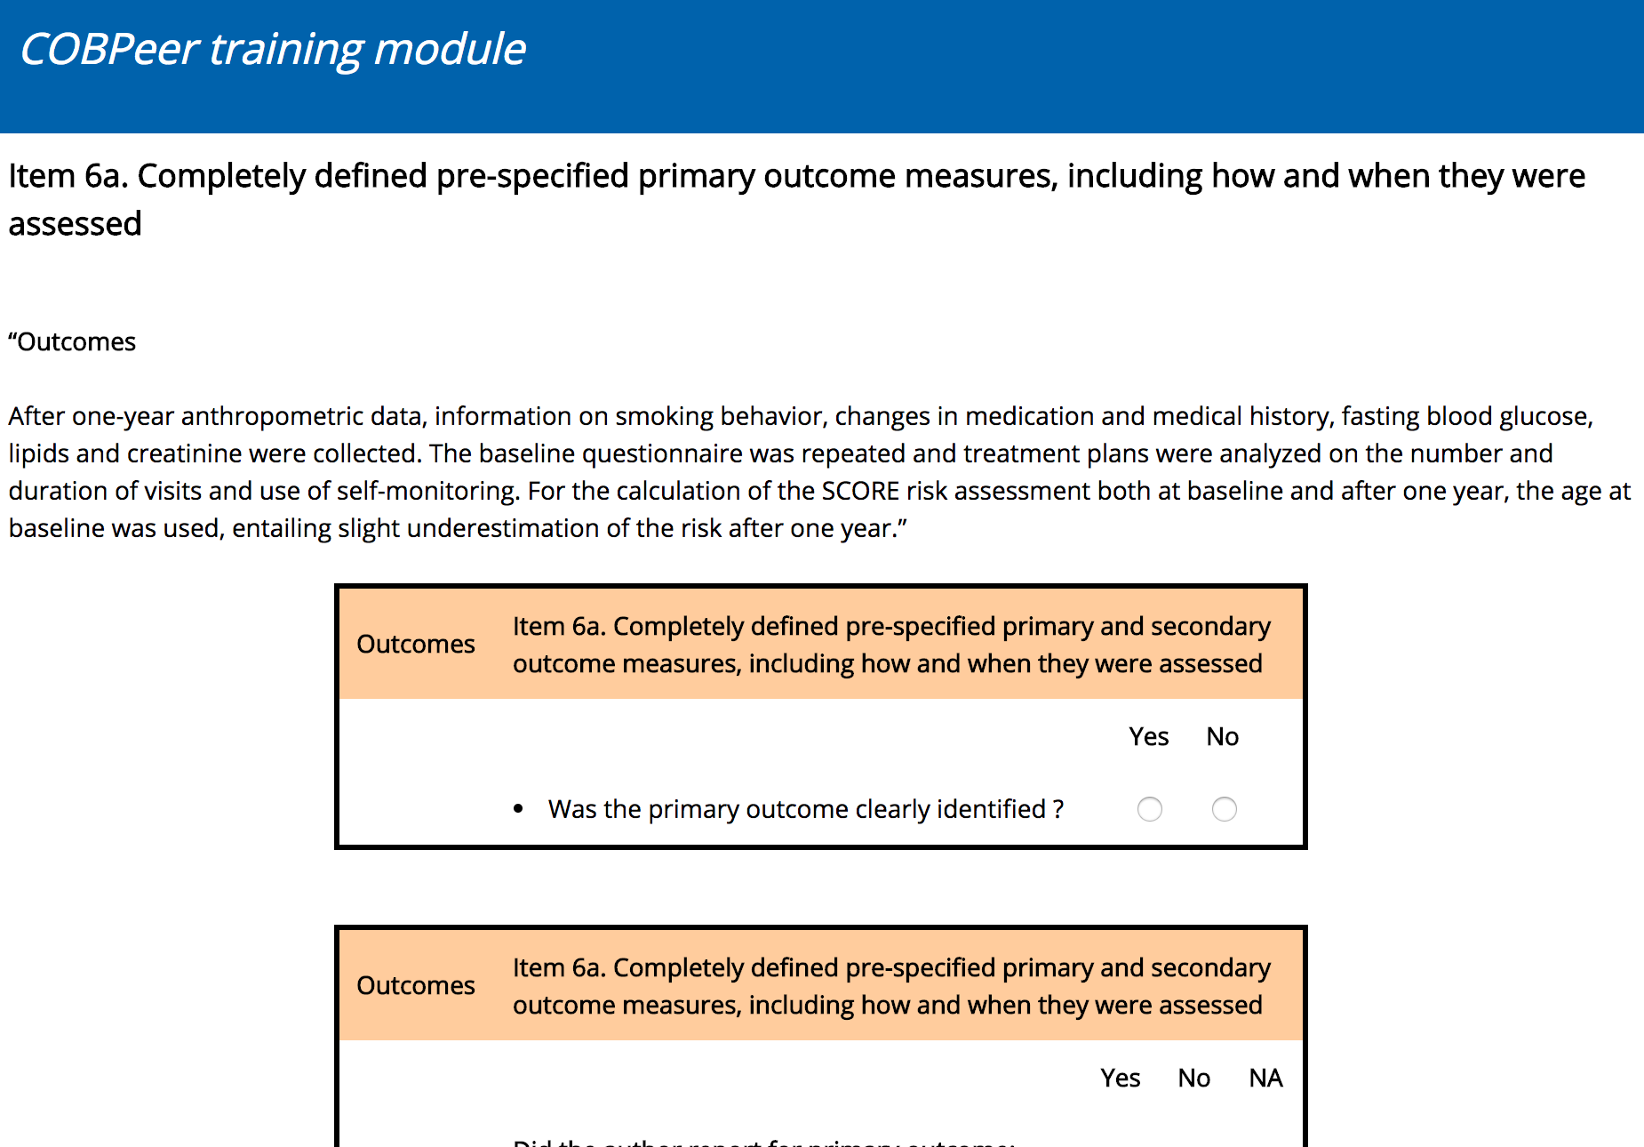
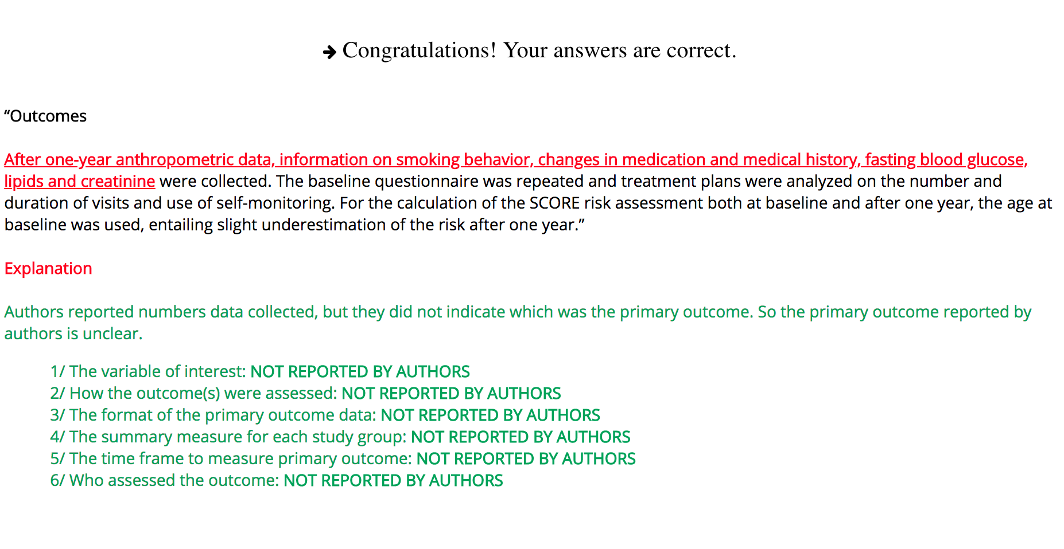
Development of the intervention – COBPeer training programme

Slide 36
Assessment of the intervention
Objective
  To compare the performance of early career peer reviewers who use the peer reviewer tool (COBPeer) with usual peer reviewers in identifying incomplete reporting and switched outcomes in reports of RCTs.
Study design
  Cross-sectional study comparing the accuracy of early career peer reviewers using COBPeer to that of usual peer reviewers when evaluating the completeness of reporting and a switched in primary outcome(s) in completed reports of RCTs at the first submission
  Gold standard: assessment of systematic reviewers

Slide 37
Assessment of the intervention
Initial submitted report
N=120
Usual peer review
Gold standard
Early career researchers
Assessment by 1 early
career researchers
with the tool
Assessment by 2 researchers
(standard peer review)
Assessment by 2
systematic reviewers
The completeness of reporting
Switched outcomes

Slide 38
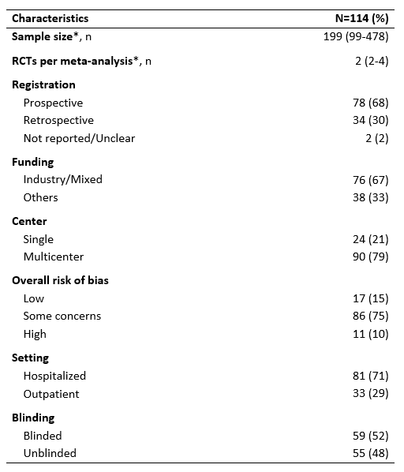
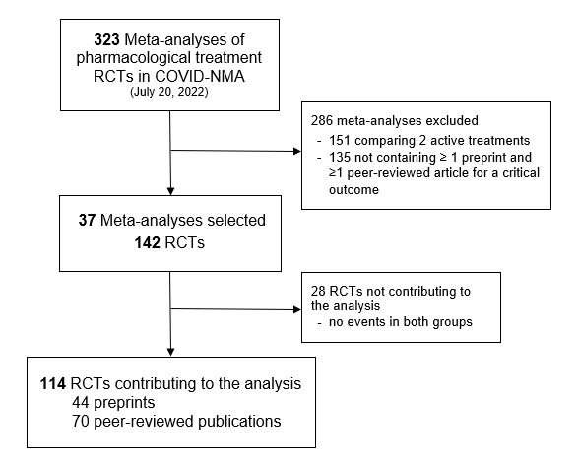
Results
* median (IQR)

Slide 39
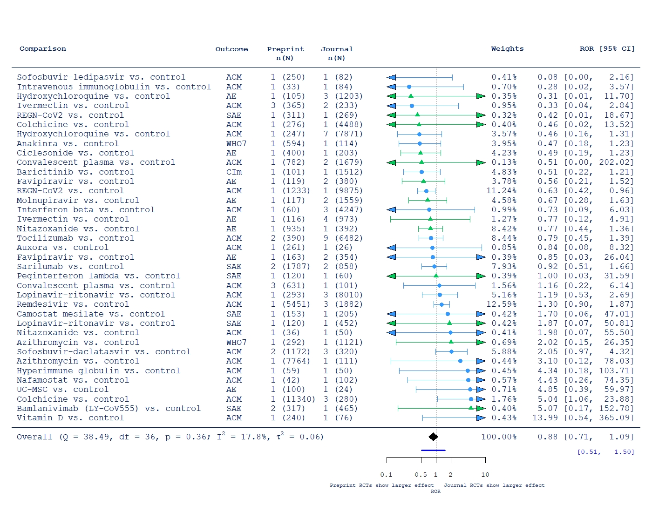
Results
Hospitalized patients
Outpatients

Slide 40
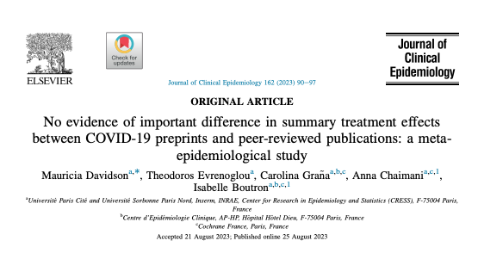

Slide 41
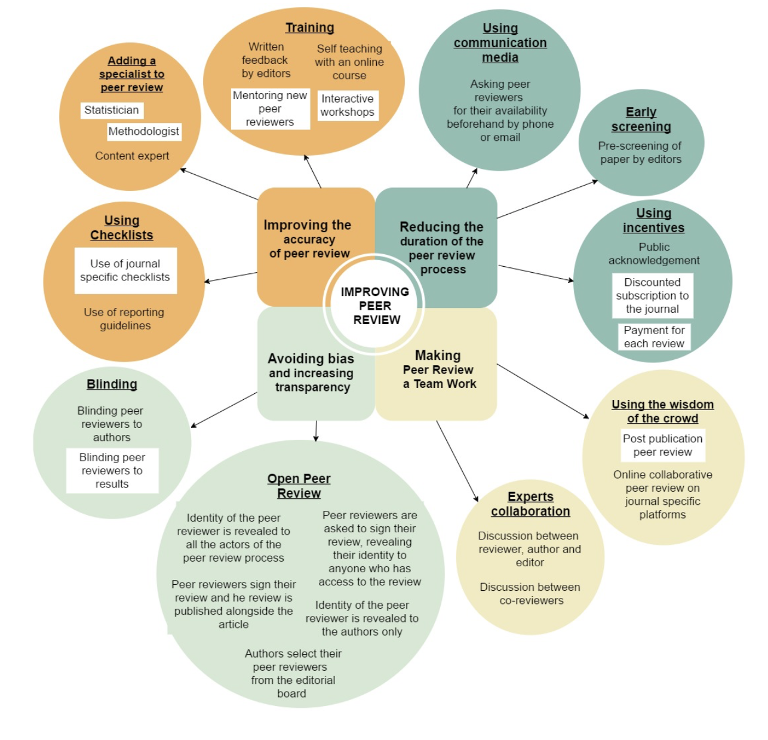
Mapping interventions?

Slide 42
What should be the study design?
  Type of manuscript (real, fabricated)
  Setting single journal, several journals, several publisher)

Slide 43
What should be the outcome?
Quality of the final manuscript (how is high quality defined, who is to decide?)
Quality of the peer review report (editor’s subjective assessment, validated scales to assess the quality of the peer review report)

Slide 44
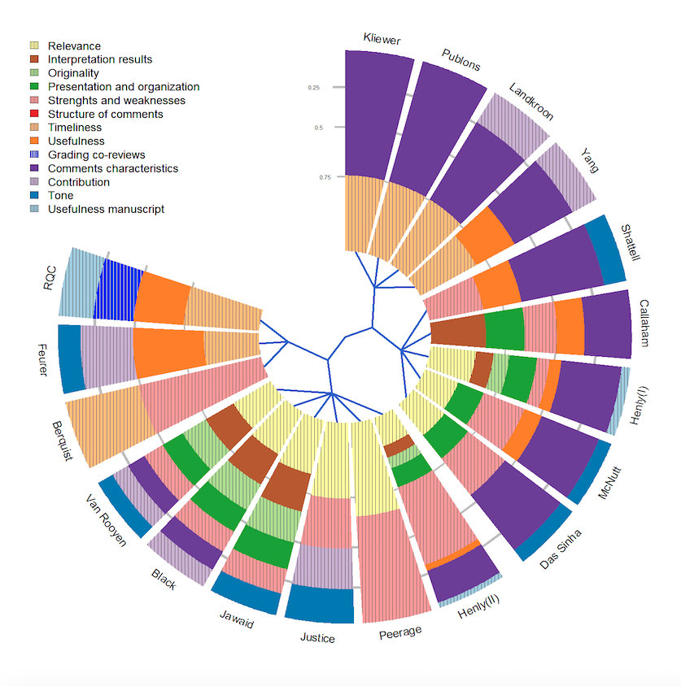
What should be the outcome?
Systematic review of all tools assessing the quality of a peer-review report
  23 scales
  1 checklist
  No tool defined the concept of quality
  Number of domains varied
Superchi C, PEERE, 2018

